Slide 1
Superstore Sales Analysis
Insights-driven dashboard using SQL + Power BI

Slide 2
Project Objective
Analyze sales, profit, and customer trends across the Superstore to uncover performance gaps, optimize discount strategies, and improve regional profitability.
Tools Used: SQL, Power BI

Slide 3
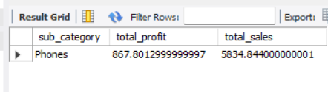
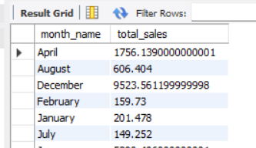

Data Exploration (via SQL)
Top subcategories
Monthly Sales Summary
Region-wise Profit

Slide 4
Interpretation
Furniture sales are high, but profit is very low.
November and December show peak sales activity.
West region has the highest profitability.

Slide 5
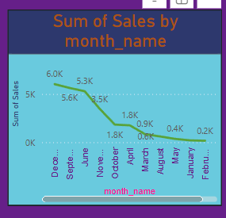
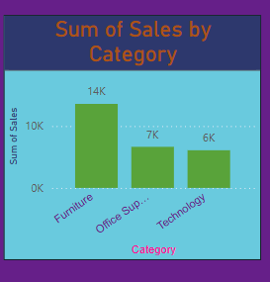
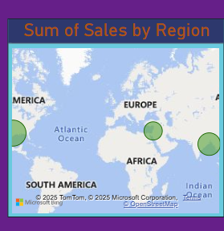
Interactive dashboard enabling region-wise filtering and deep-dive into sales and profit trends

Slide 6
Insights
California contributes 19.6% of total sales but has below-average profit margin.
Categories with >20% discount see a 15% drop in profitability.
West region leads with 32% of total profit, driven by Technology products.
Standard Class shipping takes longer but is used in 60% of orders.

Slide 7
Recommendations
Reduce discounts in Office Supplies to improve margins.
Shift customers to faster shipping methods during peak months.
Expand marketing for Phones and Accessories in underperforming regions.

Slide 8
Conclusion
Tools Used: SQL, Power BI, Excel.
Project Goal: Reveal insights to improve sales performance, optimize discounting, and track regional profitability.
Impact: Enables data-driven decision-making in retail strategy, increasing profit margins and customer satisfaction.

